Slide 1

Introduction to
Git and CI/CD

Slide 2




About me
Keagan Tomlinson
Affiliation: Cyber-Mint //everything as code
Job Profile: Backend and DevOps
Fun Fact: Proud former VC Westville student!
Achievements since graduation
Worked as a backend dev at Teamfu
Worked as a backend dev at PumpPay
Successfully migrated from github to private gitea server
Successfully migrated from circleci to git actions
Automatic backups for our gitea server
Created deploy scripts to deploy our web api’s

Slide 3

Objectives:
Understand basic Git commands and principles.
Learn about source code management principles.
Build a simple Git Actions pipeline using open-source example repositories.
Understand common Git workflows for teamwork.
Learn about resolving merge conflicts and other advanced Git topics.
Discuss best practices for managing a team using Git.

Slide 4

Materials Needed:
Git installed on each student's computer
Access to an open-source example repository

Slide 5
1. Introduction to Git (20 minutes)
Explain what Git is and why it's important for version control.
Git is a tool that tracks changes in code, allowing multiple people to work on the same project without conflicts. It stores versions of files, making it easy to revert to earlier states if needed. Git's branching system enables developers to work on features independently and merge changes seamlessly. With remote repositories, developers can collaborate from anywhere. Git promotes accountability by attributing changes to specific users. It simplifies code reviews and ensures project integrity. In summary, Git streamlines collaboration, safeguards code, and enhances efficiency in software development.
Discuss the basic Git workflow: add, commit, push, pull, fetch.
The basic Git workflow revolves around five essential commands: add, commit, push, pull, and fetch. Adding stages changes for commit, specifying which modifications to include in the next snapshot of the code. Committing records these changes into the project's history, accompanied by a descriptive message. Pushing uploads committed changes from the local repository to a remote repository, ensuring that others can access and collaborate on the codebase. Pulling retrieves changes from the remote repository and merges them into the local repository, keeping the codebase up to date. Fetching retrieves changes from the remote repository without merging them, providing an opportunity to review modifications before incorporating them into the local codebase. Together, these commands facilitate efficient collaboration, version control, and synchronization in software development projects.

Slide 6

2. Basic Git Commands
Distribute cheat sheets with simple Git commands.
Demonstrate how to add files to the staging area, commit changes, push to remote repositories, and pull changes from remotes.
Add Files to Staging Area | # Add a specific file to staging area git add filename # Add all modified files to staging area git add .
Commit Changes | # Commit staged changes with a descriptive message git commit -m "Commit message”
Push to Remote Repository: | # Push committed changes to a remote repository git push origin branch_nam
Pull Changes from Remote: | # Pull changes from a remote repository and merge into local branch git pull origin branch_name

Slide 7
Exercises 01 - Installation & basics
Create Team Wiki Project
break into teams of not more than six (6) members per team!
each generate an RSA ssh-key called id_vc
one of the team members create a Public repository with a default README.md file and a suitable .gitignore file from the available templates and an appropriate LICENSE file for your team project
add the other team members to that public repo
each team member clone the newly created repo locally
each team member edit, add a small section to the README.md
each team member should include their github profile link at the bottom of the section they added
each team member should successfully git push their changes to the server.
use git log --graph --oneline --all or git log --graph to see the commits pushed to your repo.

Slide 8
3. Git Flow and Source Code Management Principles
Versioning | Systematically tracking changes to source code over time, enabling developers to understand the codebase's history, revert to previous states, and manage releases effectively. Uses schemes like Semantic Versioning (SemVer) with major, minor, and patch versions indicating the significance of changes.
Branching Strategies | Define how code changes are managed in separate branches within a repository, facilitating parallel development, experimentation, and code isolation. Examples include GitFlow with long-lived branches for feature development and release preparation, and GitHub Flow with short-lived feature branches.
Pull Requests | Mechanism for proposing and reviewing code changes before merging them into the main codebase. Encourages collaboration, code review, and quality assurance. Developers create branches, make commits, and open pull requests for feedback and approval before integration, ensuring code meets project standards.

Slide 9
Overall, these source code management principles promote collaboration, transparency, and efficiency within development teams, enabling them to maintain a high level of code quality, manage project timelines effectively, and deliver reliable software products.
Show examples of branching strategies using visual aids or a collaborative coding session.
GitHub Flow Branching Strategy:
GitHub Flow is a simpler and more continuous approach to branching, commonly used with GitHub pull request feature:
Main Branch (e.g., main or master): Represents the production-ready code.
Feature Branches: Developers create short-lived branches for each new feature or change. These branches are typically branched off from main.short as possible.
Pull Requests: Once work is complete in a feature branch, developers open a pull request to merge changes into main. This allows for code review, discussion, and automated testing before merging.
Merge to Main: After review and approval, changes are merged into the main branch, making them available for deployment.

Slide 10
Git for Working in Teams
Exercise - Git Branching, Merging, and Collaboration
Objective: Practise branching, merging, and collaboration workflows using Git.
Setup Project:
One team member registers on teamfu.tech and creates a project (e.g., "Team Wiki").
Invite and add other team members to the project.
Create Tickets:
Add a sprint (e.g., "Sprint 02") and add tickets to this sprint.
Include feature tickets for each team member to update/add a new section.
Add one hotfix ticket to add/replace the MIT LICENSE file.
Branching and Changes:
Each team member re-clones the "Team Wiki" repo.
Create a feature branch named after the assigned ticket number.
Make changes to the wiki as per the respective ticket.
Add, commit, and push these changes to the server.
Pull Requests and Reviews:
Create a pull request (PR) and assign it to another team member for approval.
Ensure the branch is up to date with master before approving the PR.
Merging Workflow:
Merge one feature branch, then the hotfix, then the other feature branches.
Review and merge each PR as a team.
Final State:
All feature branches merged into master.
Only master, correctly updated, remains.

Slide 11
4. Building a simple git action pipeline
In your repository on GitHub.com, create a workflow file called github-actions-demo.yml in the .github/workflows directory. To do this:
If the .github/workflows directory already exists, navigate to that directory on GitHub, click Add file, then click Create new file, and name the file github-actions-demo.yml.
If your repository doesn't have a .github/workflows directory, go to the main page of the repository on GitHub, click Add file, then click Create new file, and name the file .github/workflows/github-actions-demo.yml. This creates the .github and workflows directories and the github-actions-demo.yml file in a single step.
Reminders on how to push code
git add .
git commit -m "Commit message"
git push

Slide 12
name: GitHub Actions Demo run-name: ${{ github.actor }} is testing out GitHub Actions 🚀 on: [push] jobs: Explore-GitHub-Actions: runs-on: ubuntu-latest steps: - run: echo "🎉 The job was automatically triggered by a ${{ github.event_name }} event." - run: echo "🐧 This job is now running on a ${{ runner.os }} server hosted by GitHub!" - run: echo "🔎 The name of your branch is ${{ github.ref }} and your repository is ${{ github.repository }}." - name: Check out repository code uses: actions/checkout@v4 - run: echo "💡 The ${{ github.repository }} repository has been cloned to the runner." - run: echo "🖥️ The workflow is now ready to test your code on the runner." - name: List files in the repository run: | ls ${{ github.workspace }} - run: echo "🍏 This job's status is ${{ job.status }}."

Slide 13
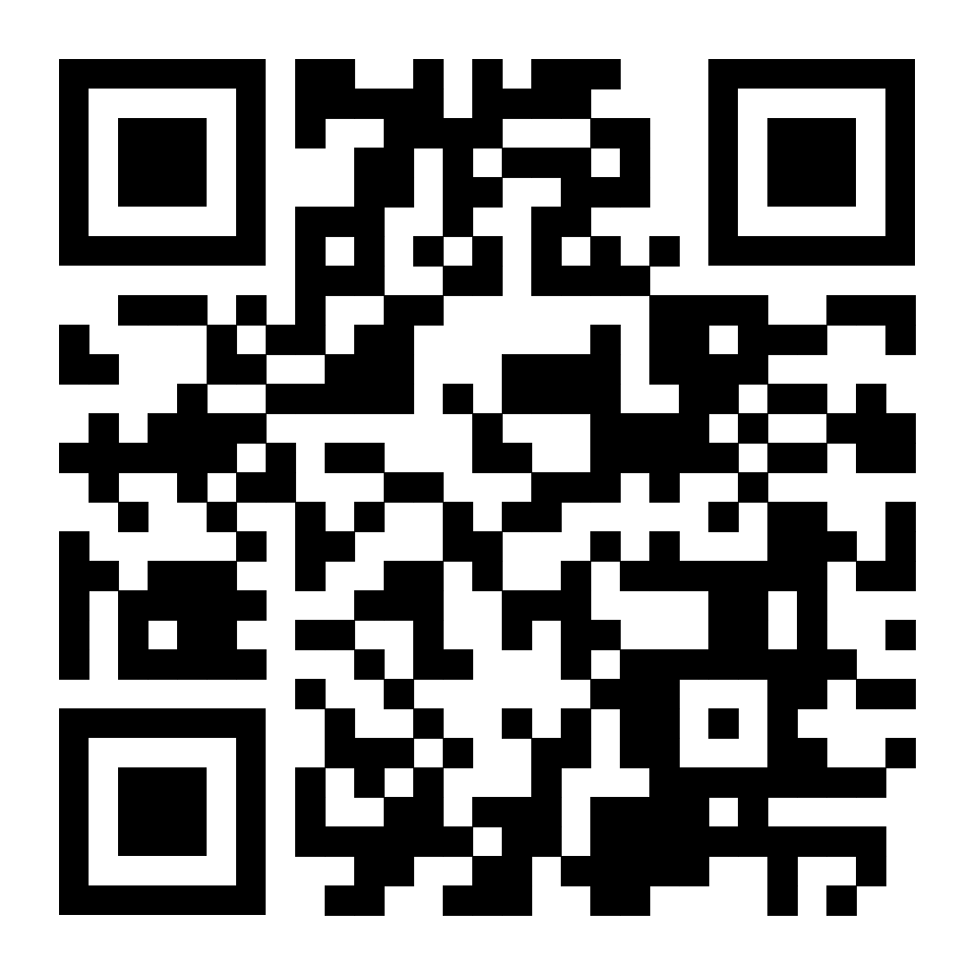
Advanced pipeline
fork the following repo
We will work together to add a
more advanced pipeline which involves
Testing and building a docker image

Slide 14
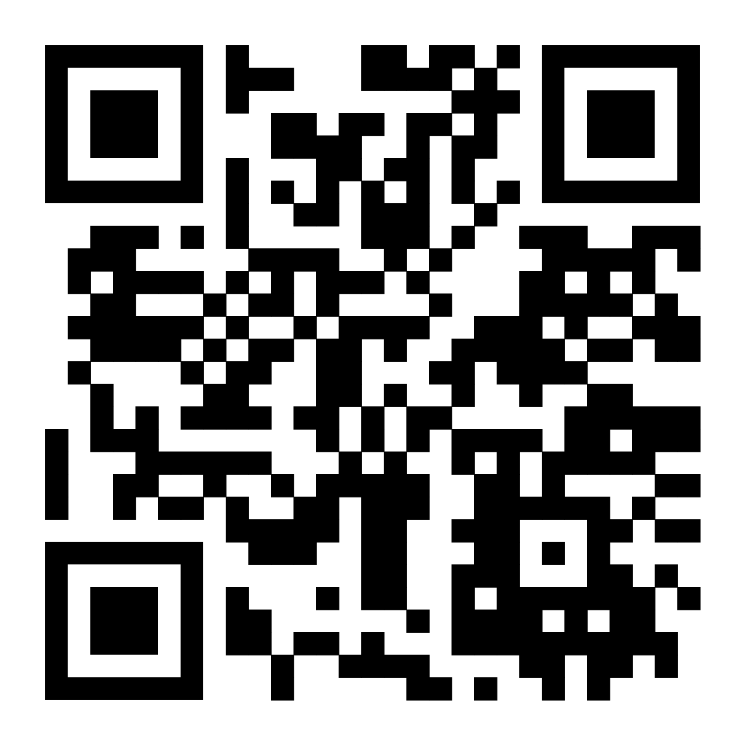
This qr code contains the link to
actionlint playground
This site checks configs for any
Issues

Slide 15
Advanced Git Topics
Git Log and Git Stats:
Git Log: Git log is a command used to display the commit history of a repository. You can use various options with git log to customize the output, such as --oneline for a condensed view, --author to filter by author, --grep to search for specific commit messages, etc.
Git Stats: Git stats provide a summary of the changes made in a repository, including the number of commits, insertions, deletions, and the most active contributors. You can use tools like git log --stat, git shortlog, or even third-party tools for more detailed analysis.
Resolving Difficult Merge Conflicts:
Understand the conflicting changes: Before attempting to resolve conflicts, it's essential to understand the changes made on both branches.
Use graphical tools: Tools like git mergetool can help visualize conflicts and aid in resolving them.
Resolve conflicts manually: Sometimes, automatic merge strategies may not work correctly. In such cases, resolving conflicts manually by editing the conflicted files is necessary.
Communicate with team members: If conflicts arise due to differences in understanding or approach, communication with team members can help in finding a consensus.

Slide 16
When to Reset the HEAD and Other Advanced SCM Topics:
Resetting HEAD: You might use git reset HEAD <file> to unstage changes from the staging area or git reset --hard <commit> to reset the branch to a specific commit. Be cautious with --hard as it can discard all changes in your working directory.
Rebase vs. Merge: Understand the differences between rebasing and merging and when to use each. Rebasing maintains a linear history, while merging preserves the branching structure.
Interactive Rebase: Interactive rebase (git rebase -i) allows you to modify commit history by combining, reordering, or squashing commits.
Git Hooks: Git hooks enable you to automate tasks before or after certain Git events, such as committing, merging, or pushing.

Slide 17
Best Practices in Git for Managing a Team
Clear Documentation and Naming Conventions: Encourage team members to maintain clear and consistent documentation for project structure, coding standards, and workflow guidelines. Establish naming conventions for branches, commits, and files to enhance clarity and organization within the repository.
Consistent Workflow Adoption: Standardize the team's Git workflow to ensure everyone follows the same process for branching, committing, and merging changes. Whether using GitFlow, GitHub Flow, or another model, consistency streamlines collaboration and reduces confusion.
Code Reviews: Emphasize the importance of code reviews as a quality assurance measure. Encourage team members to review each other's code before merging changes, providing feedback, identifying bugs, and sharing knowledge. Code reviews improve code quality, promote best practices, and foster learning within the team.
Continuous Integration (CI): Implement CI pipelines to automate the process of testing and integrating code changes into the main branch. CI systems, such as Jenkins, Travis CI, or GitHub Actions, automatically build, test, and validate code changes, ensuring that new features or bug fixes do not introduce regressions. This promotes stability and reliability in the codebase.

Slide 18
Regular Communication: Foster open communication among team members to discuss project progress, challenges, and decisions related to Git workflows. Encourage the use of collaboration tools, such as Slack, Microsoft Teams, or project management platforms, to facilitate discussions, share updates, and address issues promptly.
Version Control Etiquette: Teach team members to use Git responsibly, including committing atomic changes, writing meaningful commit messages, and avoiding unnecessary commits. Emphasize the importance of branching for feature development or bug fixes, minimizing disruptions to the main codebase.
Handling Merge Conflicts: Provide guidance on resolving merge conflicts effectively when multiple team members are working on the same files concurrently. Teach techniques for reviewing changes, communicating with team members, and resolving conflicts collaboratively to maintain code integrity.
Backup and Disaster Recovery: Educate team members on the importance of regular backups and disaster recovery plans for Git repositories. Implement strategies for backing up repositories, storing them securely, and ensuring redundancy to prevent data loss in case of accidents or system failures.

Slide 19
Signed vs Unsigned Commits
Unsigned Commits: These are commits that have not been signed with a GPG key. Anyone can make unsigned commits to a Git repository without any verification of their identity. While this is the most common scenario, it does leave room for potential security risks, as it's easier for malicious actors to impersonate others and insert unauthorized changes into the codebase.
Signed Commits: These commits are cryptographically signed by the author's GPG key. When you sign a commit, you're essentially attaching a digital signature to it, proving that you're the one who made the commit and that the content hasn't been tampered with. This adds an extra layer of security and trust to the commit history, as it ensures that the commits are authentic and haven't been altered by unauthorized parties.

